Slide 1
Turing Machines
Equivalence and Algorithms
Turing Machines
Turing machines are much more powerful models
Similar to finite automata but with an unlimited and unrestricted memory
A Turing machine is a much more accurate model of a general purpose computer

Slide 2
Turing Machines
Equivalence and Algorithms
Turing Machines
Turing machine model uses an infinite tape as its unlimited memory
It has a tape head that can read and write symbols and move around on the tape
Initially, the tape contains only the input string and blank everywhere
Machine can continue computing until it decides to produce an output
There are designated accept and reject states
It TM does not enter an accepting or rejecting state it will go on forever, never halting

Slide 3
Turing Machines
Equivalence and Algorithms
Turing Machines
. . .
 | b | b | a | a | a | a
. . .
Input/Output Tape
q₁
Reading and Writing Head (moves in both directions)
q₃
. . .
q₂
q_{n}
q₁ q₀
Finite Control

Slide 4
Turing Machines
Equivalence and Algorithms
Turing Machines vs Finite Automata
A Turing machine can both write on the tape and read from it
The read-write head can move both on the left and to the right
The tape is infinite
The special states for rejecting and accepting take effect immediately

Slide 5
Turing Machines
Equivalence and Algorithms
Example Turing Machine
Let L = {w#w : w ∈ {0, 1}∗} and M is a TM that tests membership for L
That is, we want M to accept w if w ∈ L and reject otherwise

Slide 6
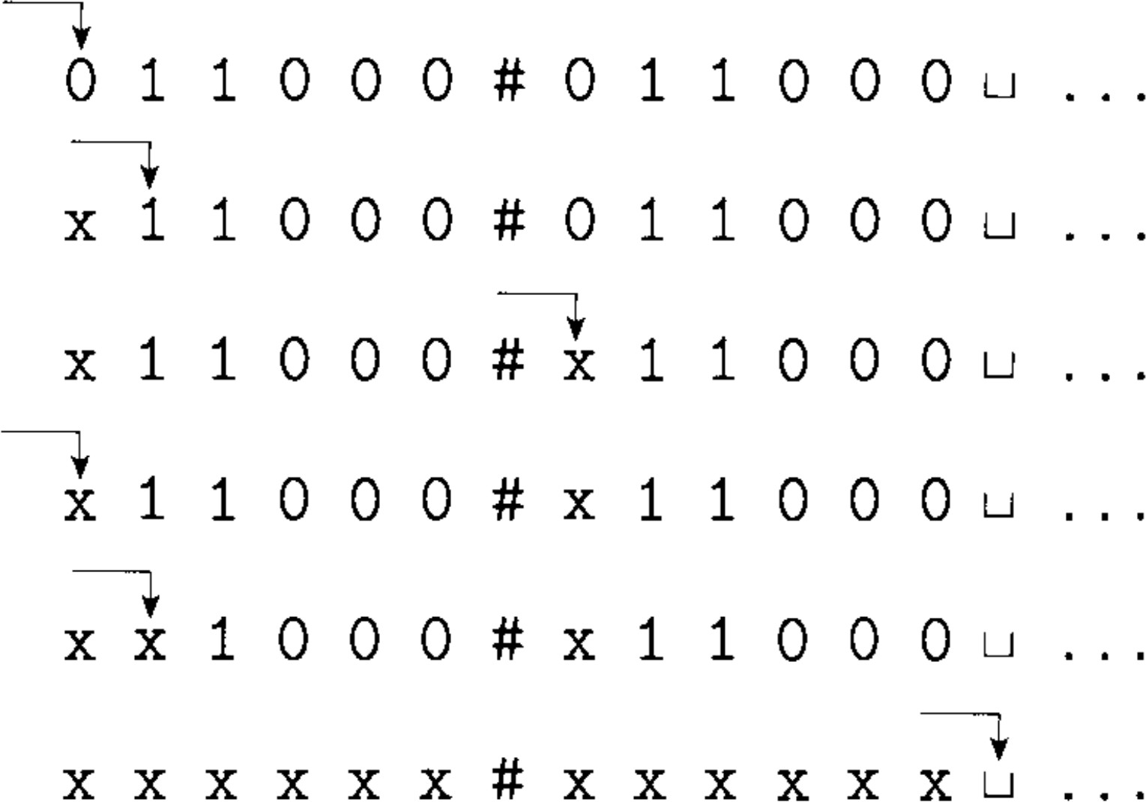
Turing Machines
Equivalence and Algorithms
Example Turing Machine
Let L = {w#w : w ∈ {0, 1}∗} and M is a TM that tests membership for L
That is, we want M to accept w if w ∈ L and reject otherwise
Assume x = 01100#01100

Slide 7
Turing Machines
Equivalence and Algorithms
Turing Machines
Turing Machine
A Turing Machine is a 7-tuple, (Q, Σ, Γ, δ, q₀, q_{accept}, q_{reject}), where
Q is the set of states,
Σ is the input alphabet not containing the blank symbol .,
Γ is the tape alphabet where . ∈ Γ and Σ ⊆ Γ,
δ : Q × Γ → Q × Γ × {L, R} is the transition function,
q₀ is the state state,
q_{accept} ∈ Q is the accept state, and
q_{reject} ∈ Q is the reject state, where q_{reject} /= q_{accept}.

Slide 8
Turing Machines
Equivalence and Algorithms
Computation by a Turing Machine
Let M = (Q, Σ, Γ, δ, q₀, q_{accept}, q_{reject}) be a Turing Machine
M receives the input w = w₁w₂ . . . w_{n} ∈ Σ∗ on the leftmost
n squares of the tape (rest of the tape is blank)
Once M starts the computation proceeds according to the transition function
Computation continues until it enters either the accept or reject states

Slide 9
Turing Machines
Equivalence and Algorithms
Computation by a Turing Machine
At any instance, the current state, the current tape contents, and the head location together are called a configuration of TM
Example configuration: 1011q₇01111 = u q v, current state is q i.e., q₇, current tape content is uv i.e., 101101111, and the head is currently on the second 0.
Suppose configuration C₁ yields configuration C₂ if the TM can legally go from C₁ to C₂ in a single step
That is, suppose we have a, b, c ∈ Gamma and u, v ∈ Γ∗ and states q_{i} and q_{j} , ua q_{i} bv yields u q_{j} acv if
δ(q_{i}, b) = (q_{j}, c, D)
where D = L if M moves leftward and D = R if M moves rightward

Slide 10
Turing Machines
Equivalence and Algorithms
Turing Machine
Turing Recognizable
A language L is called Turing-recognizable if some Turing machine recognizes it. L is also called recursively enumerable language.

Slide 11
Turing Machines
Equivalence and Algorithms
Turing Machine
Turing Recognizable
A language L is called Turing-recognizable if some Turing machine recognizes it. L is also called recursively enumerable language.
Turing Decidable
A language L is called Turing-decidable or decidable if some Turing machine decides it. L is also called recursive language.

Slide 12
Turing Machines
Equivalence and Algorithms
Turing Machines
Let L = {0^{n}1^{n} : n ≥ 1}
Symbols
X
0 1
q₀ (q₁, X, R) −
q₁ (q₁, 0, R) (q₂, Y, L) q₂ (q₂, 0, L) −
q₃ − −
q₄ − −
Y
(q₃, Y, R)
state
B
−
−
−
⁻ (q₁, Y, R)
−
(q₀, X, R) (q₂, Y, L)
− (q₃, Y, R)
− −
(q₄, B, R)
−

Slide 13
Turing Machines
Equivalence and Algorithms
Turing Machine
Y →Y,R
0→0,R
0 → X, R
1 → Y, L
start
q₀
q₁
q₂
Y →Y,L
0→0,L
_{Y → Y, R} X → X, R
B → B, R
q₃
q₄
Y → Y, R

Slide 14
Turing Machines
Equivalence and Algorithms
Turing Machine
Let L = {a^{i}b^{j}c^{k} : i × j = k ∧ i, j, k ≥ 1}
TM M on input string w:
Scan the input from left to right to determine whether it is a member of a∗b∗c∗ and reject otherwise
Return the head to the left-hand end of the tape
Cross off an a and scan to the right until a b occurs. Shuttle between the b’s and c’s crossing off one of each until all b’s are gone. If all c’s have been crossed off and some b’s remain reject
Restore the crossed off b’s and repeat stage 3 if there is
another a to cross off. If all a’s have been crossed off, determine whether all c’s also have been crossed off. If yes accept, reject otherwise

Slide 15
Turing Machines
Equivalence and Algorithms
Variants of Turing Machines
Multitape Turing Machines
δ : Q × Γ^{k} → Q × Γ^{k} × {L, R, S}^{k}
where k is the number of tapes, the expression
δ(q_{i}, a₁, . . . , a_{k}) = (q_{j}, b₁, . . . , b_{k}, L, R, . . . , L)
means if TM is in state q_{i} and heads 1 through k reading symbols a₁ through a_{k}, the machine goes to state q_{j} , writes symbols b₁ through b_{k} and directs each head to move left, right, or stay put as specified

Slide 16
Turing Machines
Equivalence and Algorithms
Equivalence
Theorem 1
Every multitape Turing machine has an equivalent single-tap Turing machine.

Slide 17
Turing Machines
Equivalence and Algorithms
Equivalence
Theorem 1
Every multitape Turing machine has an equivalent single-tap Turing machine.
Corollary 2
A language is Turing-recognizable if and only if some multitape Turing machine recognizes it.

Slide 18
Turing Machines
Equivalence and Algorithms
Nondeterministic Turing Machines
An NTM is defined in the expected way
At any point in computation the machine may proceed according to several possibilities
Transition function for NTM:
δ : Q × Γ → P(Q × Γ{L, R})

Slide 19
Turing Machines
Equivalence and Algorithms
Nondeterministic Turing Machines
An NTM is defined in the expected way
At any point in computation the machine may proceed according to several possibilities
Transition function for NTM:
δ : Q × Γ → P(Q × Γ{L, R})
Theorem 3
Every nondeterministic Turing machine has an equivalent deterministic Turing machine.

Slide 20
Turing Machines
Equivalence and Algorithms
Equivalence with Other Models
Many different variants of Turing machines are equivalent in computational power
In fact other computational modesl which are very different thatn TM’s are also equivalent as long as they satisfy some reasonable requirements such as the ability to perform only a finite amount of work in a single step
These models are often called conventional models of computation
This has a philosophical implication
Due to equivalence of computational models the class of algorithms that these models describe remains the same

Slide 21
Turing Machines
Equivalence and Algorithms
Hilbert’s 10-th Problem
In 1900, David Hilbert in his famous lecture identified twenty five mathematical problems as a challenge for the 20-th century mathematicians
On the problems in this 25 problem list, specifically the 10-th problem (famously known as Hilbert’s tenth problem) as an important question, the problem describes “devise an algorithm that tests whether a polynomial has an integral root.”
Hilbert did not use the word algorithm but he assumed there must exist such a procedure

Slide 22
Turing Machines
Equivalence and Algorithms
Hilbert’s 10-th Problem
In 1900, David Hilbert in his famous lecture identified twenty five mathematical problems as a challenge for the 20-th century mathematicians
On the problems in this 25 problem list, specifically the 10-th problem (famously known as Hilbert’s tenth problem) as an important question, the problem describes “devise an algorithm that tests whether a polynomial has an integral root.”
Hilbert did not use the word algorithm but he assumed there must exist such a procedure
Unfortunately, no such algorithm/procedure exits
This cannot be understood unless the formal definition of algorithms is known which Alonzo Church and Alan Turing defined
Which later became Church-Turing thesis

Slide 23
Turing Machines
Equivalence and Algorithms
Hilbert’ 10-th Problem
We can define this problem with differnt language
Let D = {p : p is a polynomial with an itegral root}
The question then becomes, Is D decidable?
Of course the answer is no
However, D is Turing-recognizable
We can construct such a TM, HOW?

